Slide 1

The Journey to OpenID Federation 1.0 and the Road Ahead
Michael B. Jones
Giuseppe De Marco
Roland Hedberg
April 21, 2026

Slide 2
Structure of Today’s Presentation
Quick Overview of OpenID Federation Background and Goals
  Touching on Spec Features Achieving Those Goals
The Journey to OpenID Federation 1.0
What’s Next for OpenID Federation

Slide 3
OpenID Federation
OpenID Federation Specification
  https://openid.net/specs/openid-federation-1_0.html
  Enables establishment and maintenance of multi-lateral federations
Incorporates lessons learned from SAML-based federations
  Defines hierarchical JSON-based metadata structures for federation participants
  Entities can be in multiple federations
  Federations can be in federations

Slide 4
Establishing Trust within a Federation
How do a Relying Party and an Identity Provider know that they’re in the same federation?
  Important for trust, liability, accountability, and reliability
Shibboleth/SAML approach
  Federation Operator polls participants for their metadata, concatenates it into a huge flat file, and distributes it to all nightly (written in 2020)
  In production use, but brittle and not scalable
    SAML world developing Metadata Query protocol to try to move away from this
OpenID Federation approach
  Hierarchical metadata, where organizations publish metadata about themselves and Federation Operators publish statements about subordinate organizations
  Scalable, maintainable

Slide 5
Two Federations with Some Members in Common
.-----------------. .-----------------.
| Trust Anchor A | | Trust Anchor B |
'------.--.-------' '----.--.--.------'
| | | | |
.--' '---. .-------------------' | |
| | | | |
.---v. .-----v-v------. .-----------' |
| OP | | Intermediate | | |
'----' '--.--.--.-----' | .---------v----.
| | | | | Intermediate |
.-------' | '------. | '---.--.--.----'
| | | | | | |
.--v-. .-v--. .v--v. .---' | '----.
| RP | | RS | | OP | | | |
'----' '----' '----' | .--v-. .-v--.
| | RP | | RP |
| '----' '----'
|
.-------v------.
| Intermediate |
'----.--.--.---'
| | |
.-----' | '----.
| | |
.--v-. .--v-. .-v--.
| OP | | RP | | AS |
'----' '----' '----'

Slide 6
Use of Hierarchical Metadata
Each leaf member publishes self-signed metadata about itself
  Relying Parties
  Identity Providers
  Other Entity Types, such as those for wallet ecosystems
Organizations publish signed metadata about the members that belong to them
Federation operators publish signed metadata about orgs
Inter-federations publish signed metadata about federations
Hierarchical metadata is an online graph data structure

Slide 7
Trust Chains
Participants follow metadata trust chains from leaves up to common roots, verifying signatures
Both participants are members of a federation if a common Trust Anchor is found
Participants can be members of multiple federations

Slide 8
Metadata Representation
Each metadata statement is a signed JSON Web Token (JWT)
  These are called Entity Statements
They make statements about
  The Entity itself
  Keys used by the Entity
  Policies of the Entity
  Superior entities that they are willing to trust
    This is how trust chains can be followed to federation roots

Slide 9
Example Entity Statement
{
"iss": "https://feide.no",
"sub": "https://ntnu.no",
"iat": 1516239022,
"exp": 1516298022,
"jti": "7l2lncFdY6SlhNia",
"metadata_policy": {
"openid_provider": {
"issuer": {"value": "https://ntnu.no"},
"organization_name": {"value": "NTNU"},
"id_token_signing_alg_values_supported":
{"subset_of": ["RS256", "RS384", "RS512"]},
}
},
"jwks": {
"keys": [
{
"e": "AQAB",
"kid": "key1",
"kty": "RSA",
"n": "pnXBOusEANuug6ewezb9J_...",
"use": "sig"
}
]
},
"authority_hints": [
"https://edugain.org/federation"
]
}

Slide 10
Collecting a Trust Chain
Start with self-signed Entity Statement – First Entity in Trust Chain
From the claim authority_hints, pick superior Entity
Grab superior’s self-signed Entity Statement (using .well-known)
Request superior’s view of subordinate (federation API). Add to the Trust Chain
GOTO 1
Repeat until superior is a trusted Trust Anchor
C1
B1
C0
B0
RP
OP

Slide 11
The Journey to OpenID Federation 1.0 and the Road Ahead

Slide 12
The Journey to OpenID Federation 1.0
In the beginning, there was SAML
  SAML 2.0 became a standard in March 2005
  Leaders in R&E built multi-lateral federations using SAML
Then along came OpenID Connect
  OpenID Connect became a standard in February 2014
At TNC 2016 in June, Lucy Lynch challenged Roland Hedberg:
  “If there is someone who should be able to bring the eduGAIN identity federation into the new world of OpenID Connect, it is you.”
Roland wrote first draft within months in late 2016

Slide 13
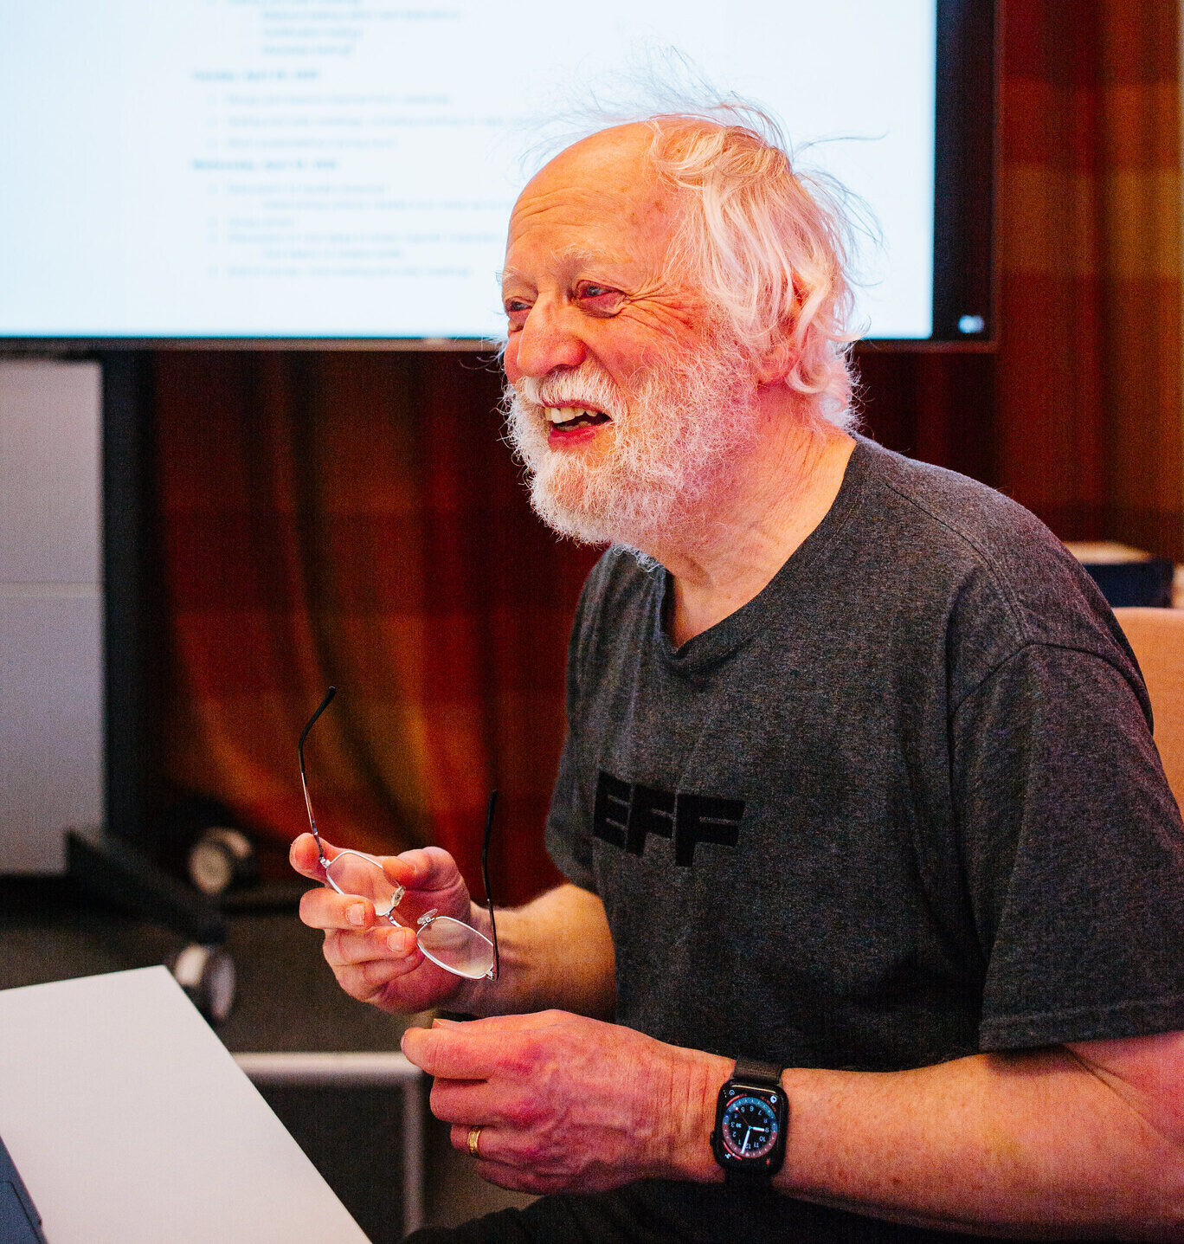
Roland Hedberg at the 2025 Interop Event at SUNET in Stockholm

Slide 14
Adding to the Early Editorial Team
Mike Jones, John Bradley joined Roland Hedberg as editors in 2017
Heather Flanagan (then RFC Editor) detailed review 2017
First Implementer’s Draft (draft 04) approved in January 2018
Andreas Åkre Solberg of Uninett joined as editor in October 2018
  Adding Implicit Registration (later renamed Automatic Registration)
  Enables federated parties to interact without pre-registration
Second Implementer’s Draft (draft 10) approved in November 2019

Slide 15
Federation Events Shaping the Spec
Spec informed by discussions at many federation events
  NORDUnet 2017, Copenhagen
  SURFnet 2018, Utrecht
  Internet2 Technology Exchange/REFEDS 2019, New Orleans
  OpenID Japan Workshop 2020, Tokyo
  GÉANT TNC/REFEDS 2022, Trieste
  Internet2 Technology Exchange/REFEDS 2022, Denver
  TIIME 2024, Copenhagen
  Internet2 Technology Exchange/REFEDS 2025, Denver
  TIIME 2026, Amsterdam

Slide 16
Interop Events Along the Journey
Repeatedly interoperating among implementations refined spec
  Much like five interops were held for OpenID Connect
  Interop results were used to improve the specification
Hackathon & interop with multiple implementations at Internet2/REFEDS 2019
OpenID Foundation held three (virtual) interop events in 2020
Third Implementer’s draft (draft 17) approved September 2021
Interop event in Stockholm at SUNET in April 2025
  30 participants, 14 implementations, 15 countries including AU, NZ!
  Read about it at https://self-issued.info/?p=2697
Interop event in Amsterdam at TIIME in February 2026
  12 people, 9 implementations, 9 countries
    Croatia, Finland, Greece, Italy, Netherlands, Poland, Serbia, Sweden, US
  Read about it at https://self-issued.info/?p=2807
  This one organized by the community – not the OpenID Foundation!

Slide 17
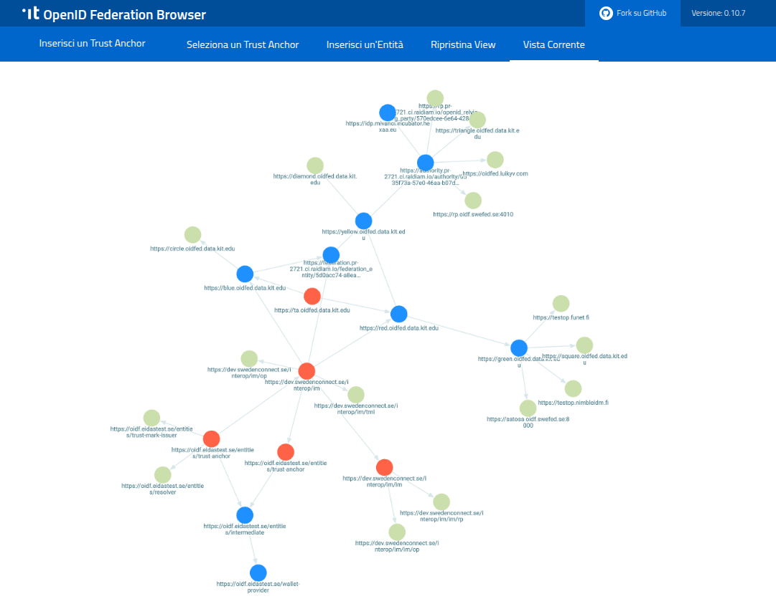
OpenID Federation Browser View of KIT Federation during 2025 SUNET Interop

Slide 18
Significant Developments Mid-Journey
Many open source implementations
  See https://openid.net/developers/openid-federation-implementations/
Trust Marks added, April 2020
Connect2ID Server product implementation, August 2020
Italy decided to use Third Implementer’s Draft (draft 17) for national federations (SPID/CIE), 2022
Giuseppe De Marco added as an editor, June 2022
Vladimir Dzhuvinov added as an editor, October 2022
  Tightened metadata policy processing
Historical Keys Endpoint added, October 2022
Authlete Server product implementation, January 2023
“OpenID Connect Federation” became “OpenID Federation”, October 2023
  Recognizing that core functionality is protocol-independent

Slide 19
Gaining Momentum
Italy decides to use OpenID Federation for EUDI Wallet
  Giuseppe creates OpenID Federation Wallet Architectures spec
Sweden decides to use OpenID Federation for multiple national federations, including healthcare
Australia decides to use OpenID Federation for Open Banking / Open Finance
  OpenID Federation Extended Subordinate Listing extension created
Netherlands and Finland collaborate on a Federation profile
Shibboleth OpenID Federation implementation
eduGAIN OpenID Federation pilot

Slide 20
Pushing for Completion
Fourth Implementer’s Draft (draft 36) published, May 2024
  Many cleanups made in preparation for this draft
  Made what we believed would be the last sets of breaking changes
    Including changing some parameter names for consistency
  Read about the changes made at https://self-issued.info/?p=2560
Draft underwent formal security analysis by University of Stuttgart
  Something the OpenID Foundation believes is important
  For instance, FAPI1, FAPI2 also analyzed
  OpenID4VP specs will also be analyzed

Slide 21
Findings from 2024 Security Analysis
Actionable vulnerability in audience values of Client Registration JWTs detected
  https://openid.net/notice-of-a-security-vulnerability/
Applies to:
  OpenID Federation
  OpenID Connect private_key_jwt registration
  RFC 7523 (JWT Client Authentication)
  RFC 9126 (Pushed Authorization Requests)
  Client-Initiated Backchannel Authentication (CIBA)
All have been or are being updated to address the vulnerability

Slide 22
Federation Integrity & Metadata Integrity
2024 Security Analysis also identified that two important federation properties may not hold
  Federation Integrity and Metadata Integrity
  Whether two parties interacting in a Federation are using the same Trust Chain and Metadata values
Read about them at https://connect2id.com/blog/how-to-link-an-app-protocol-to-an-openid-federation-trust-layer
trust_chain and peer_trust_chain header parameters were added to be able to ensure these properties

Slide 23
Long Journey from Almost Final to Final
We thought we were essentially done in mid-2024 with ID4
The security analysis told us differently
Feedback from emerging deployments told us differently
Stockholm interop event in April 2025 told us differently
We kept getting more feature requests – not fewer!
What to do…?

Slide 24
How We Finished
We asked the clarifying question “Must this feature be in OpenID Federation 1.0?”
  If a feature was essential for the core spec, we included it
  If a feature could be done as a non-breaking extension, we left it for future work
  If we hadn’t asked that question, we probably still wouldn’t be done
OpenID Federation 1.0 became a standard February 17, 2026!

Slide 25
The Road Ahead
Finishing one successful journey is often the start of the next
Continued adoption is the next frontier
  Application areas include authentication, digital wallets, open finance, and possibly AI agents
Trust establishment with OpenID Federation is protocol independent
  But protocol-specific profiles are needed to apply it in context

Slide 26
Protocol-Specific Federation Profiles
OpenID Federation for OpenID Connect 1.1
  Extracted OpenID Connect profile from OpenID Federation 1.0
  Exactly equivalent to what’s in 1.0, but editorially separated
  Vote to approve as Final starts today!
OpenID Federation for Wallet Architectures 1.0
  Based on Italian EUDI Wallet choices
  Finishing this specification is next priority on our journey

Slide 27
Federation Extensions in Progress
OpenID Federation Extended Subordinate Listing
  Extends OpenID Federation to facilitate listings of large numbers of subordinates
OpenID Federation Subordinate Events Endpoint
  Specifies a mechanism for Trust Anchors and Intermediates to publish historical events related to their Immediate Subordinates
OpenID Federation Entity Collection
  Defines an endpoint to retrieve a filterable list of all resolvable entities in a (sub-)federation. Useful for populating the set of IdPs in a Federation for home realm discovery user interfaces.

Slide 28
Second Security Analysis
Security analysis of Final OpenID Federation 1.0 approved
  University of Stuttgart security analysts have begun this work
  Updates the formal model used in analysis to match final space
  Will verify that audience security vulnerability fixed
  Will verify that Federation Identity and Metadata Integrity achievable

Slide 29
OpenID Federation Testing Resources
OpenID Certification Tests for OpenID Federation
  https://openid.net/certification/federation_testing/
Metadata tests created by Connect2ID
  https://connect2id.com/blog/metadata-policy-test-vectors-openid-federation

Slide 30
OpenID Federation Resources
OpenID Federation Specification
  https://openid.net/specs/openid-federation-1_0.html
My talk at TIIME 2026 describing OpenID Federation in detail
  https://self-issued.info/?p=2805
OpenID Connect Working Group Specifications
  https://openid.net/wg/connect/specifications/
OpenID Blog
  https://openid.net/
Mike Jones’ Blog
  https://self-issued.info/

Slide 31
Backup Slides

Slide 32
SAML vs. OpenID Federation
SAML
Appearing in a metadata file means you are part of a federation
OpenID Federation
Entities with Trust Chains up to the same Trust Anchor belong to the same federation

Slide 33
SAML vs. OpenID Federation
SAML
An entity’s complete metadata must be accepted by the federation operator for the entity to be allowed into the federation
OpenID Federation
The federation operator sets the boundaries of what is acceptable

Slide 34
Policy Language for Entity Statements
Policy Operators
  subset_of
  one_of
  superset_of
  add
  value
  default
  essential
Constraints
  max_path_length
  naming_constraints
  allowed_entity_types

Slide 35
Applying Metadata Policies
Policies applied top-down from root to leaves of trust chain
Policies higher in the chain override those lower in the chain
For instance, a Federation Operator might specify that only a particular set of signing algorithms may be used
  Policies are applied to all subordinate entities in the federation

Slide 36
SAML vs. OpenID Federation
SAML
It is rare that an entity belongs to more then one federation. I believe that eduGAIN recommends that an entity only belong to one.
OpenID Federation
There is no drawback to belonging to multiple federations

Slide 37
SAML vs. OpenID Federation
SAML
The is no metadata negotiation
OpenID Federation
The RP proposes and the OP decides, subject to applicable policies from the Trust Chain

